Slide 1

MooMarket
1905009,1905010,1905020,
1905021,1805017,1805066

Slide 2
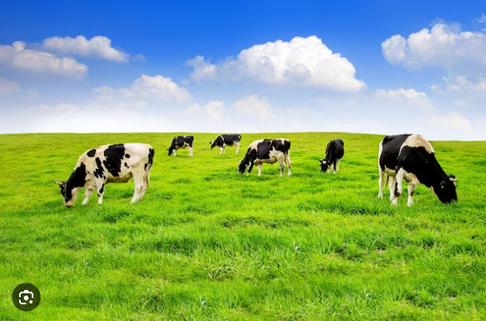


From farm to fork unveiling the Farmer-to-butcher process
Keeps track of livestock management essentials includes appropriate housing, feeding, and health issues.
Helps farmers to source livestock.
Suggests farmers feed and nutrition for ruminants.
Avoiding hassle caused by middleman.
Encourage farmers to ensure ethical practices for veterinary care.
Provides proper guidelines of slaughter and processing.
Perform proper analytics to avoid sudden price hike.

